Slide 1
BATTLEMAPS
Terraforming Comparisons

Slide 2
22 MAY 2016 – ISLAND Variation

Slide 3
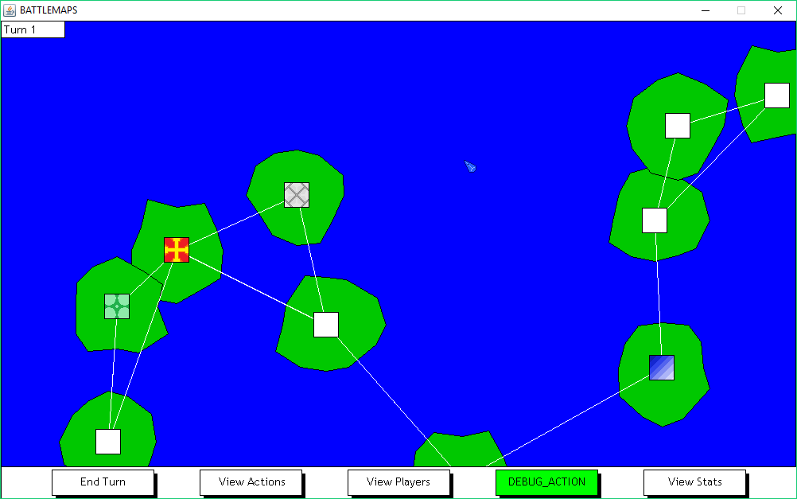
Count = 3, Rate = 0.0

Slide 4

Count = 3, Rate = 0.2

Slide 5


Count = 2, Rate = 0.5

Slide 6
Count = 3, Rate = 0.5

Slide 7

Count = 4, Rate = 0.5

Slide 8

Count = 3, Rate = 0.7

Slide 9

Count = 3, Rate = 0.8

